Slide 1
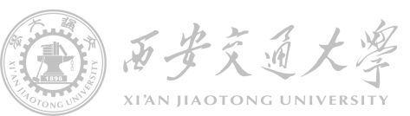

Power electronics device in ordinary life
Seminar #1 Report
810 | Nie Yongxin
 | Chang Yi
 | She Xiaoliang

Slide 2








Brief introduction
Function
Basic principle
Input and output features
Dismantling diagram
category
Circuit diagram
Component

Slide 3



目录
Category
Background information
The specific meaning of switching power supply is to use modern electronic technology to control the switching time ratio and maintain stable output voltage. At present, the switching power supply with the characteristics of small size, light weight, high stability and easy to carry is more popular. In addition, these characteristics of switching power supply make it widely used in many electronic devices.
The future development of switching power supply must be high frequency, high reliability, good safety, low energy consumption, less pollution and strong anti-interference ability. At present, many foreign countries make use of the characteristics of switching power supply to continuously develop new high intelligent components. They have more professional technology on the loss of secondary rectifier components, and increase scientific and technological innovation in power ferrite materials to increase high frequency and large magnetic flux density to obtain higher magnetic properties.
Introduction
function
principle
features
dismentling
circuit
component

Slide 4
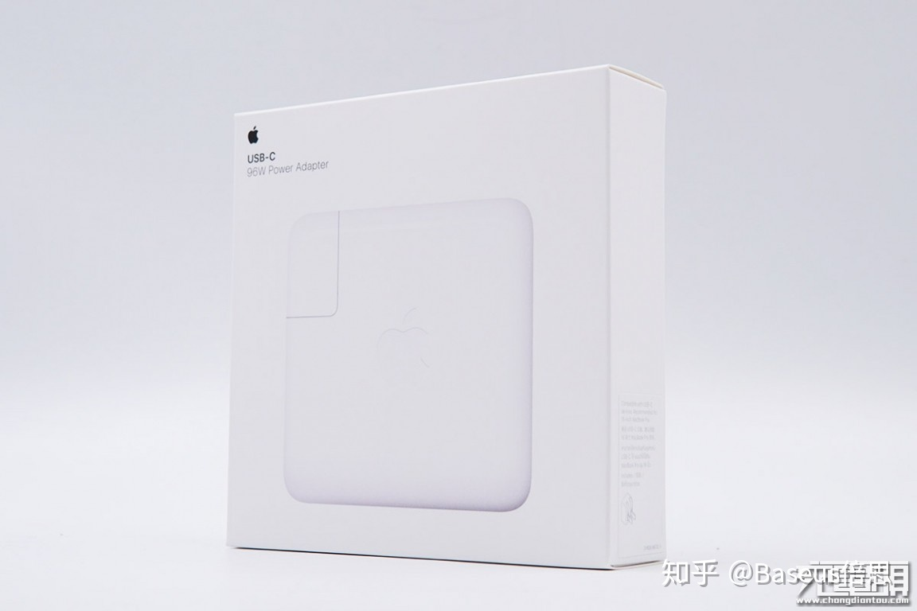

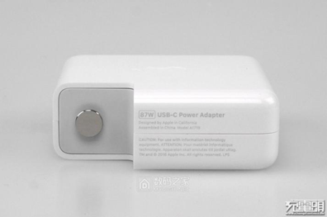
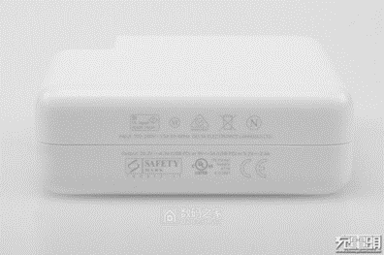
目录
Category
The 96W Power Adapter for Mac
Introduction
function
principle
features
dismentling
circuit
component

Slide 5
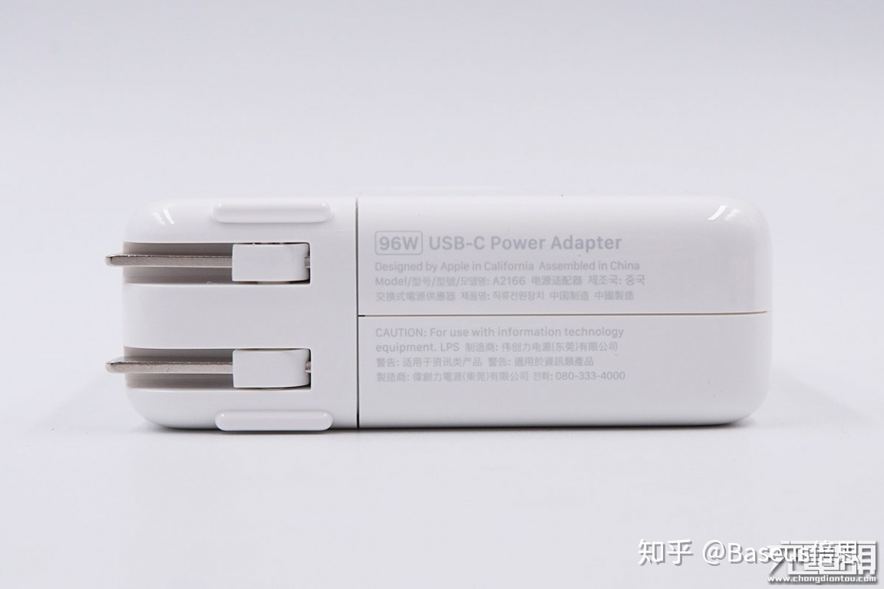
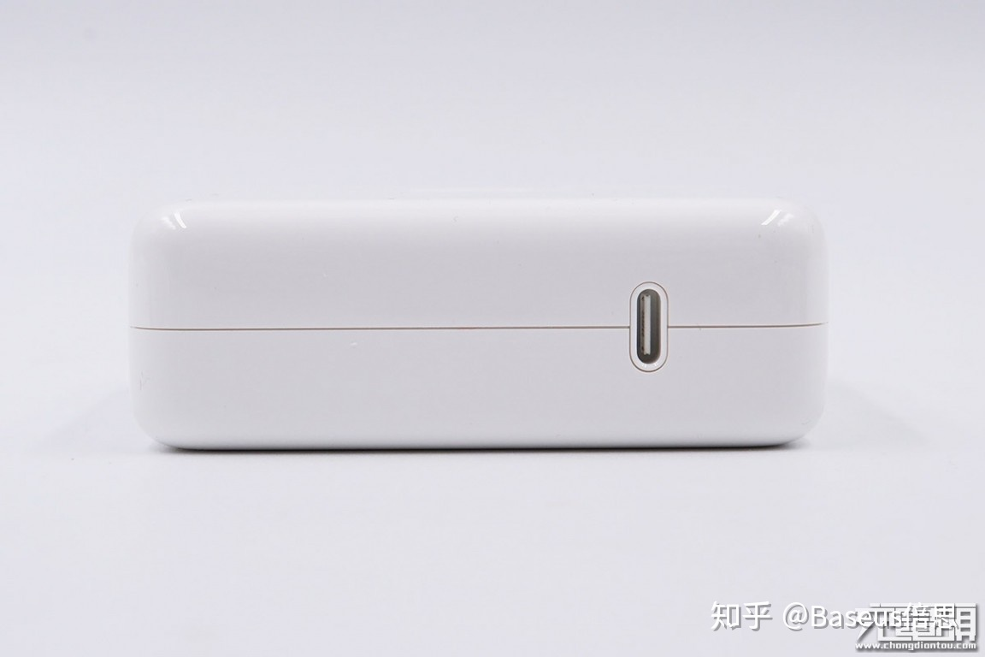
目录
Basic function
Category
To begin with, the adapter is used to charge the Macbook, a kind of laptop produced by Apple Inc, whose power stage is 98 watts. This adapter support input voltage, from 100V to 240V, input current, 1.5A and the frequency, from 50Hz to 60Hz. Meanwhile, the adapter also supports 4 different kinds of output features including 20.5V+4.7A, 15V+3A, 9V+3A and 5.2V+3A, which could be used as the charger of any equipment supporting PD charging.
Introduction
function
principle
features
dismentling
circuit
component

Slide 6
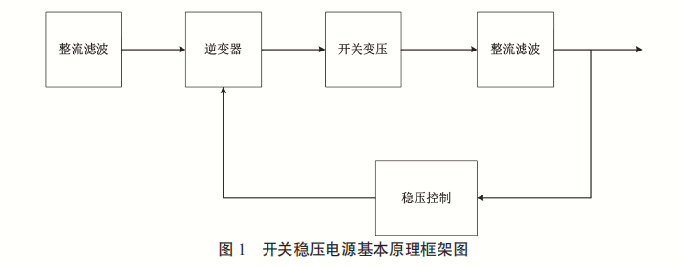
目录
Basic principle of switching power supply
Category
Introduction
function
principle
features
dismentling
circuit
component

Slide 7
目录
specific input and output features
Category
Introduction
function
principle
features
dismentling
circuit
component

Slide 8
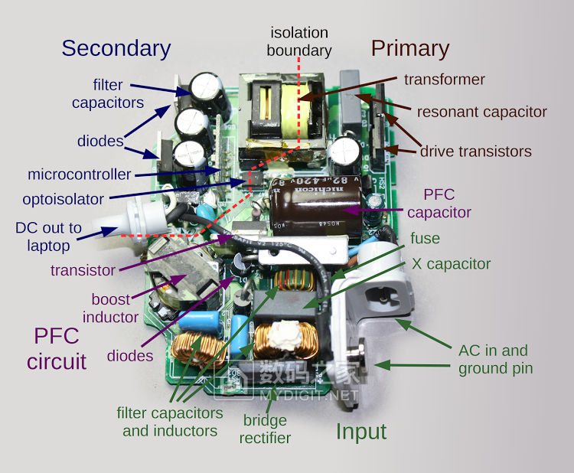
目录
dismantling diagram
Category
Introduction
function
principle
features
dismentling
circuit
component

Slide 9
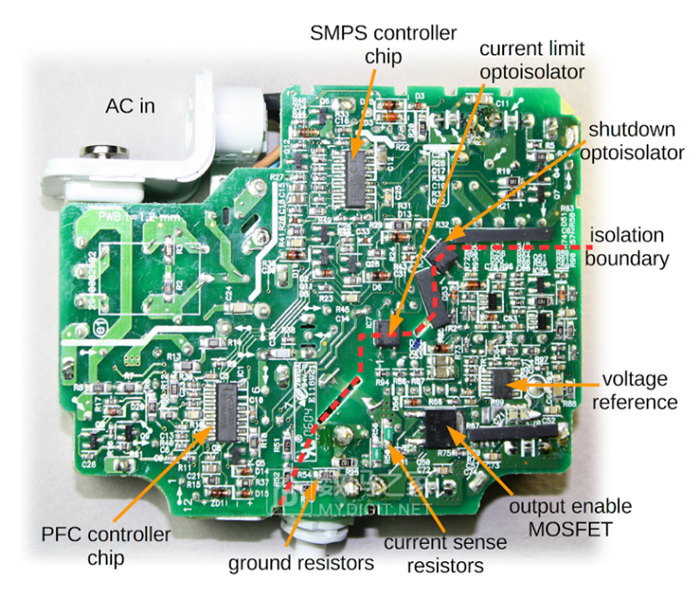
目录
dismantling diagram
Category
Introduction
function
principle
features
dismentling
circuit
component

Slide 10
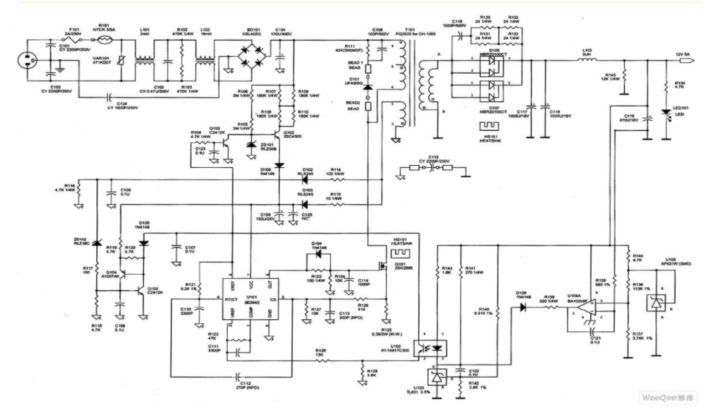
目录
Circuit diagram
Category
Introduction
function
principle
features
dismentling
circuit
component

Slide 11
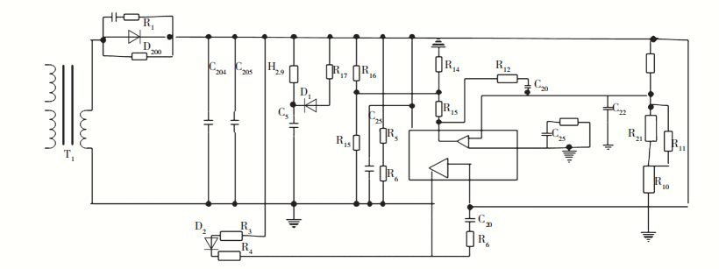
目录
Category
Control circuit schematic diagram
Introduction
function
principle
features
dismentling
circuit
component

Slide 12
目录
Category
Introductory remarks
Introduction
(1) Varistor. When the voltage reaches a certain height, the value of varistor will be adjusted rapidly, and its value will become infinitely small. The fuse in series in the circuit will be quickly blown, and other components in the circuit will be well preserved.
(2) Inductance coil. Inductance coil is mainly used to reduce battery interference.
(3) Rectifier bridge. The main function of rectifier bridge is to convert 220 V alternating current into direct current.
function
principle
features
dismentling
circuit
component

Slide 13
目录
Category
Introductory remarks
Introduction
(4) Filter capacitor. The main function of the filter capacitor is to filter out the AC wave in the direct current to ensure the safe and reliable operation of the circuit.
(5) Temperature probe. The temperature probe is used to detect the operating temperature of the power adapter. When the working temperature of the power adapter reaches a certain temperature, the temperature probe will automatically cut off the output current to ensure that other components in the adapter are in good condition.
function
principle
features
dismentling
circuit
component

Slide 14
目录
Category
Introductory remarks
Introduction
(6) High power switch tube. High power switch tube is an important part of switching power supply in the project, and its function is to control the switch.
(7) Switching transformer. Switching transformer is one of the core components of switching power supply.
(8) Secondary rectifier tube. The main function of secondary rectifier is to convert low voltage alternating current into low voltage direct current.
function
principle
features
dismentling
circuit
component

Slide 15
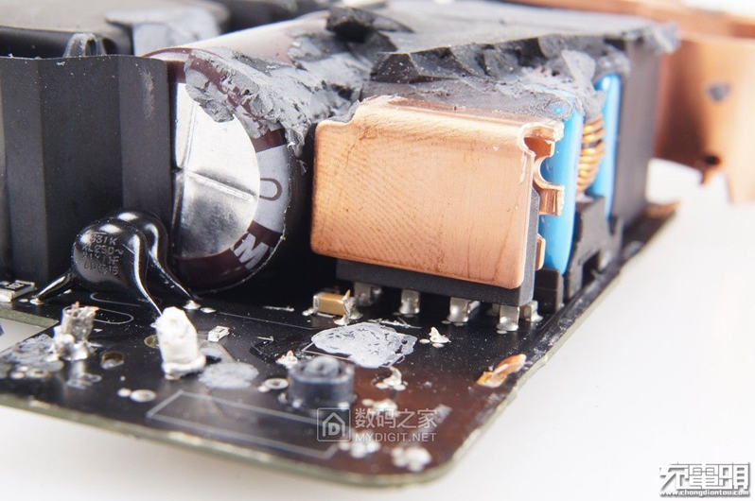
目录
Category
Component – KBP408G
Introduction
function
principle
features
dismentling
circuit
component

Slide 16
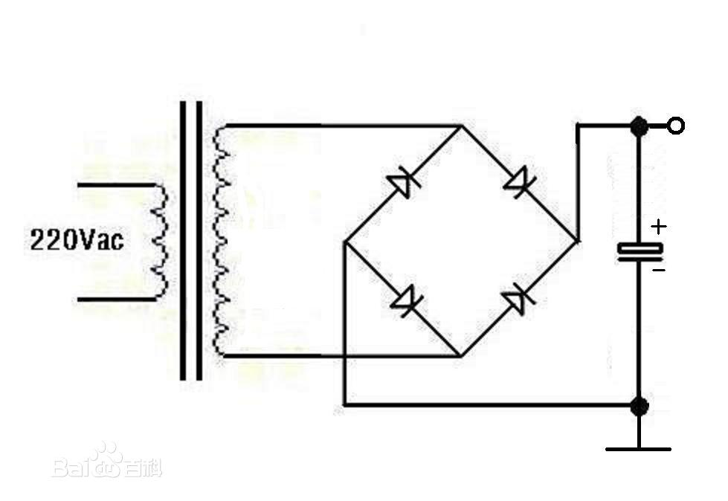
目录
Category
Bridge rectifier circuit
Introduction
bridge rectifier is an improvement of diode half wave rectifier.
Half wave rectifier uses the undirectional conduction characteristics of diode. When the input is standard sine wave, the positive half of the output sine wave is obtained and the negative half part is lost.
function
principle
features
dismentling
circuit
component

Slide 17
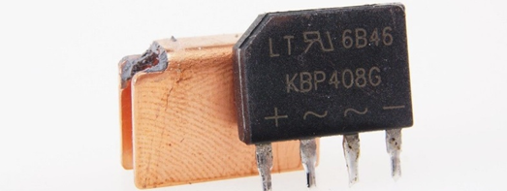
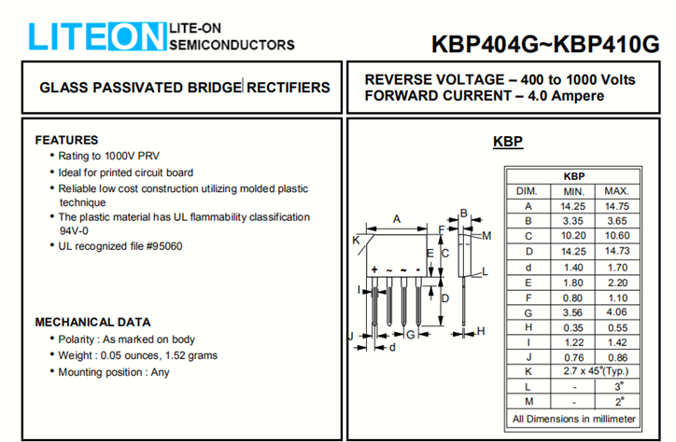
目录
Component
KBP408G
Category
Introduction
function
principle
features
dismentling
circuit
component

Slide 18
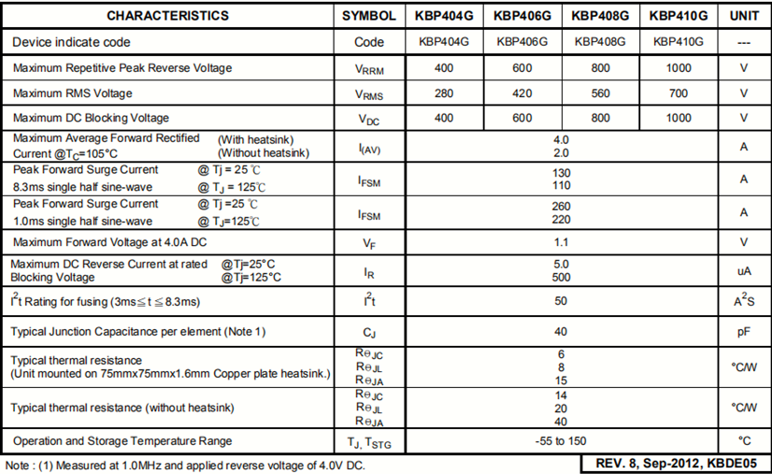
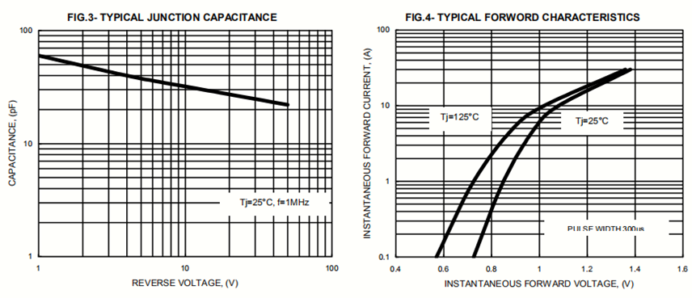
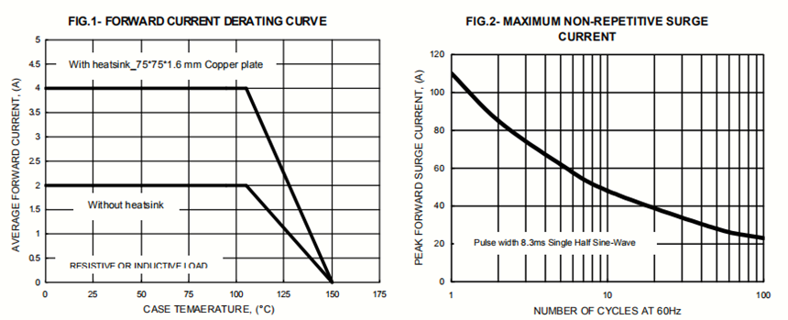
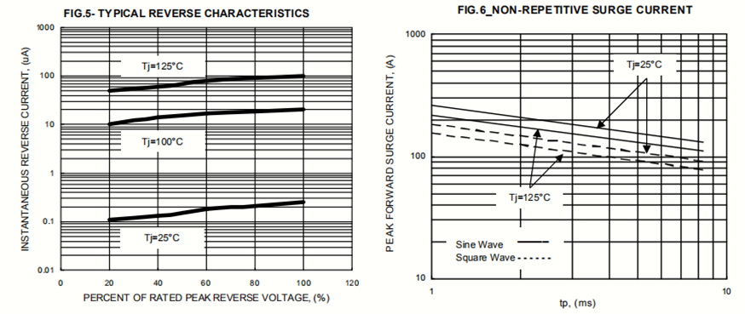
KBP408G
目录
Category
Introduction
function
principle
features
dismentling
circuit
component

Slide 19

Questioning session
Your questions and
your valuable comments
are welcome

